Slide 1
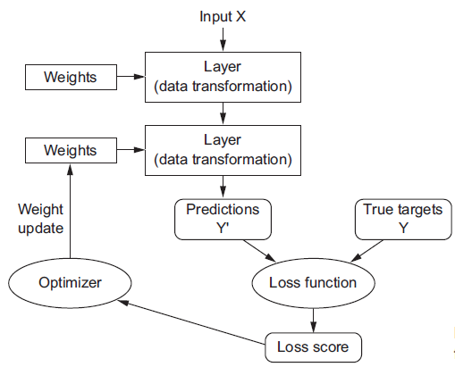
Optimization for Training Deep Models
sigmod/softmax/…
binary cross entropy/mse/…
adam/rmsprop/…
Adapted from Lecture slides of Deep Learning By Ian Goodfellow

Slide 2

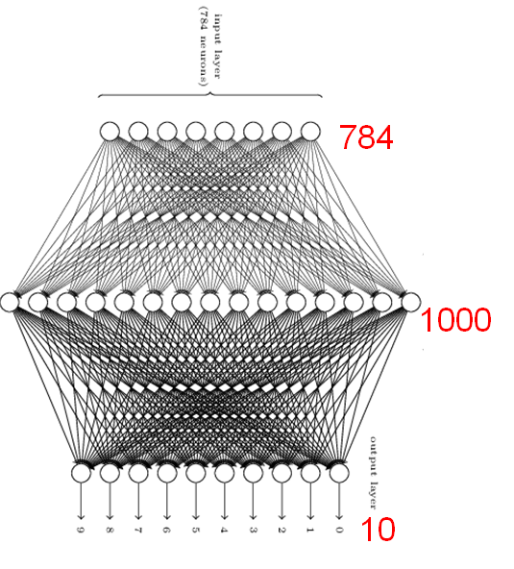
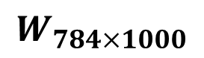
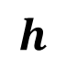
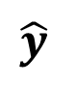
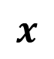
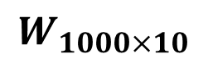
A Simple Neural Network for Image Recognition
from keras.datasets import mnist
import numpy
from keras.datasets import mnist
from keras.models import Sequential
from keras.layers import Dense
from keras.layers import Dropout
from keras.utils import np_utils
(X_train, y_train), (X_test, y_test) = mnist.load_data()
28×28 pixels
$$x$$
$$W_{784×1000}$$
$$h$$
num_pixels = X_train.shape[1] * X_train.shape[2]
X_train = X_train.reshape(X_train.shape[0], num_pixels).astype('float32')
X_test = X_test.reshape(X_test.shape[0], num_pixels).astype('float32')
$$W_{1000×10}$$
$$\hat{y}$$
y_train = np_utils.to_categorical(y_train)
y_test = np_utils.to_categorical(y_test)
num_classes = y_test.shape[1]
model = Sequential()
model.add(Dense(1000, input_dim=784,activation='relu', kernel_regularizer = l2(0.01)))
model.add(BatchNormalization())
model.add(Dense(10, activation='softmax', kernel_regularizer = l2(0.01)))
from keras.optimizers import Adam
model.compile(loss='categorical_crossentropy', optimizer='adam', metrics=['accuracy'])
history = model.fit(X_train, y_train, validation_data=(X_test, y_test), epochs=100, batch_size=1024, verbose=1)

Slide 3

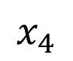
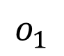
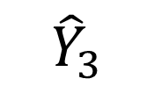
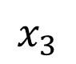
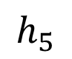
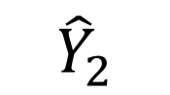
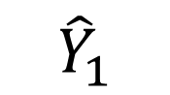
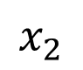
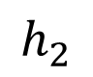
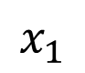
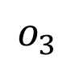
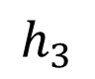
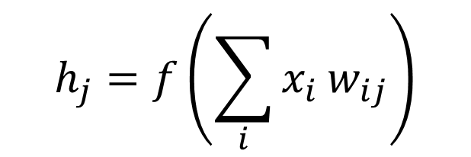
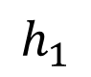
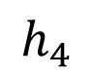
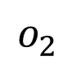
Learning/Training:
Stochastic Gradient Decent to adjust the weights
Training Data
(Output)
Training Data (Input)
w₀₁₁
$$h_{1}$$
Minimize
Loss
X1 | X2 | X3 | X4
4 | 0 | 12 | 5
8 | 1 | 32 | 7
… | … | … | …
… | … | … | …
5 | 1 | 30 | 3
9 | 0 | 16 | 4
w₁₁₁
Y1 | Y2 | Y3
0 | 1 | 0
1 | 0 | 0
… | … | …
… | … | …
1 | 1 | 0
0 | 0 | 1
$$x_{1}$$
w₁₁₂
1
2
$$h_{2}$$
$$o_{1}$$
$${\hat{Y}}_{1}$$
1
2
0.7
0.1
0.2
$$x_{2}$$
…
…
$$h_{3}$$
$$o_{2}$$
$${\hat{Y}}_{2}$$
…
…
$$x_{3}$$
$$h_{4}$$
$$o_{3}$$
$${\hat{Y}}_{3}$$
N
N
$$x_{4}$$
w₁₄₄
w₁₄₅
$$h_{5}$$
w₀₇₃
Network outputs shall be close to target outputs.
i.e., Loss shall be minimized.
機器學習要項：
資料集
模型
損失函式
優化器
$$h_{j}=f\left(\sum_{i}{x_{i}}w_{ij}\right)$$
f : activation function

Slide 4
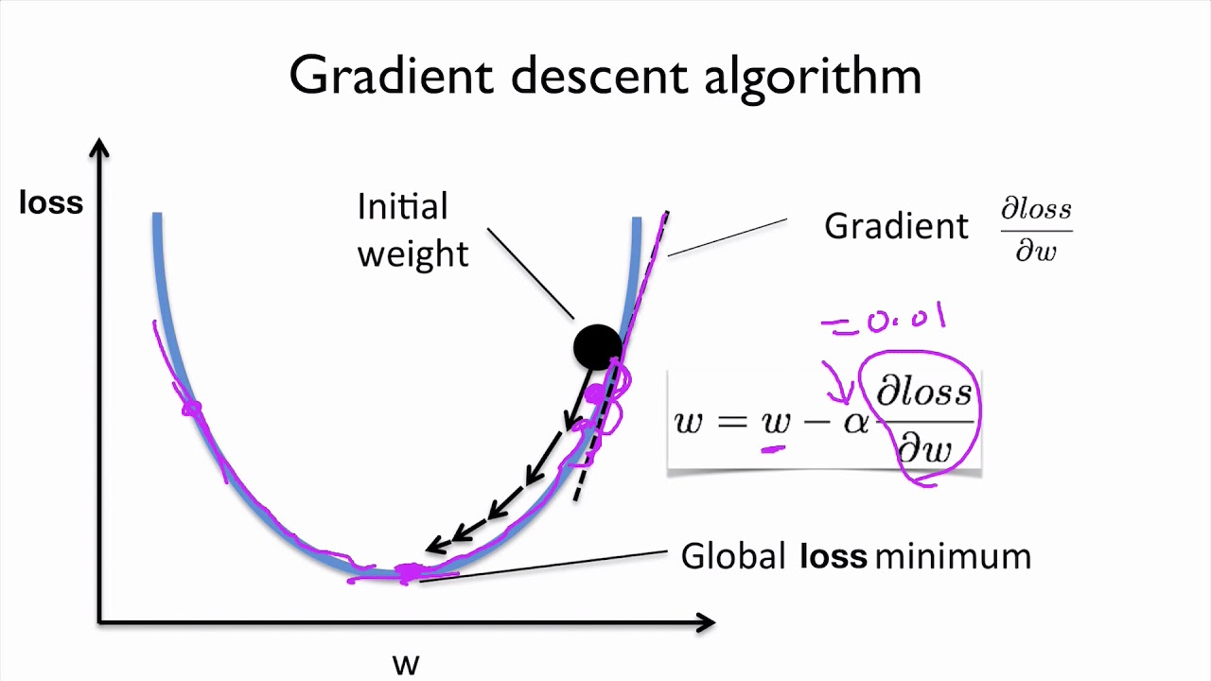
Learning rate
Loss/cost/error represents the difference between current outputs and target outputs.

Slide 5


Slide 6
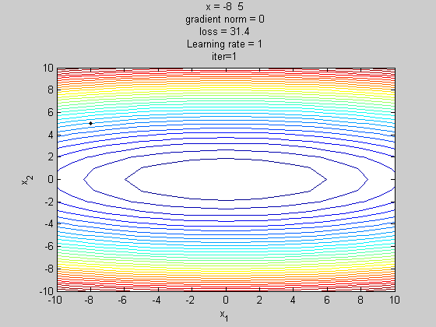
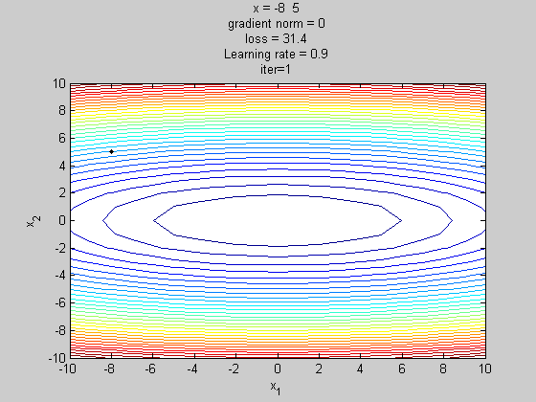

Effect of Learning Rate
Learning rate = 1.0
Learning rate = 0.9
Learning rate = 0.5

Slide 7
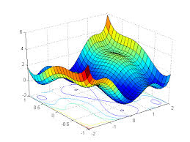
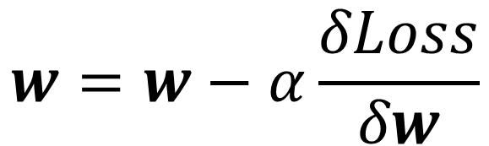
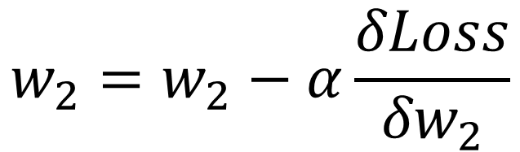
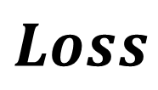
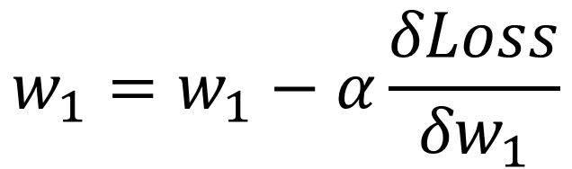
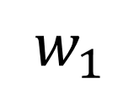
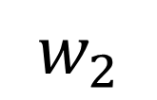
Problems:
Some regions are flat and some are steep.
In a region, some direction is flat and some is steep.
$$Loss$$
$$w=w−α\frac{δLoss}{δw}$$
$$w_{1}=w_{1}−α\frac{δLoss}{{δw}_{1}}$$
$$w_{2}=w_{2}−α\frac{δLoss}{{δw}_{2}}$$
$$w_{1}$$
Solutions:
Include momentum (for P.1)
Adaptive learning rates (for P.2)
$$w_{2}$$

Slide 8
Optimizers
Stochastic gradient descent (SGD)
SGD with momentum
AdaGrad
RMSProp
RMSProp with momentum
Adam

Slide 9
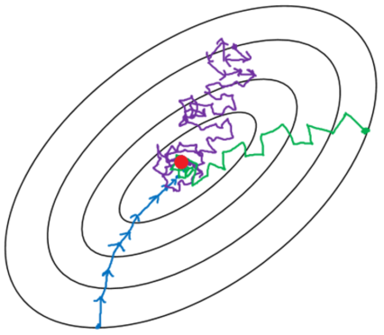
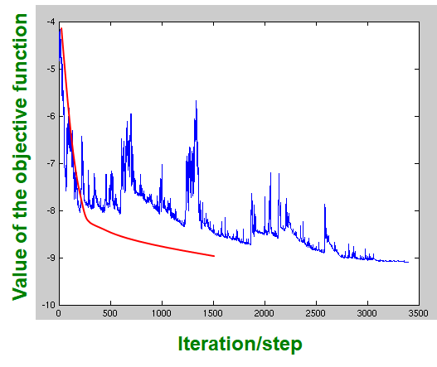
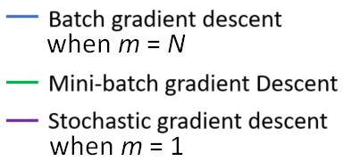
m = 1
Mini-batch
Min-Batch/SGD
GD
m = N
m = N
Note: If m is equal to N (the number of data points), SGD becomes Gradient Descent (GD).

Slide 10
Local optimal
global
optimal
Figure 8.4: Optimization based on downhill moves can fail if the local surface does not point toward the global solution.
Here we provide an example of how this can occur, even if there are no saddle points and no local minima. This example cost function contains only asymptotes toward low values, not minima.
The main cause of difficulty in this case is being initialized on the wrong side of the “mountain” and not being able to traverse it.
In higher dimensional space, learning algorithms can often circumnavigate such mountains but the trajectory associated with doing so may be long and result in excessive training time, as illustrated in figure 8.2.
Notes:
Asymptote: 漸近線

Slide 11
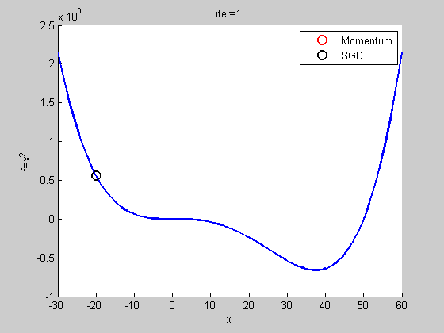
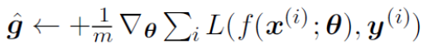
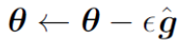
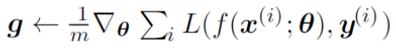
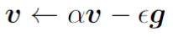
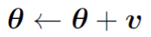
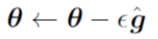
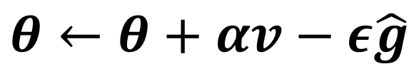
SGD vs SGD with Momentum
Stochastic Gradient Descent:
SGD with Momentum:
Momentum helps to escape local minimum.
Without/With momentum:
$$θ←θ+αv−ε\hat{g}$$

Slide 12
gradient descent
with momentum
gradient descent
without momentum
Figure 8.5: Momentum aims primarily to solve two problems: poor conditioning of the Hessian matrix and variance in the stochastic gradient.
Here, we illustrate how momentum overcomes the first of these two problems. The contour lines depict a quadratic loss function with a poorly conditioned Hessian matrix. The red path cutting across the contours indicates the path followed by the momentum learning rule as it minimizes this function. At each step along the way, we draw an arrow indicating the step that gradient descent would take at that point. We can see that a poorly conditioned quadratic objective looks like a long, narrow valley or canyon with steep sides.
Momentum correctly traverses the canyon lengthwise, while gradient steps waste time moving back and forth across the narrow axis of the canyon. Compare also the figure at the right, which shows the behavior of gradient descent without momentum.

Slide 13
# with momentum
The momentum algorithm introduces a variable v that plays the role of velocity—it is the direction and speed at which the parameters move through parameter space.
The velocity is set to an exponentially decaying average of the negative gradient.
The name momentum derives from a physical analogy, in which the negative gradient is a force moving a particle through parameter space, according to Newton’s laws of motion.
Notes:
First law: an object either remains at rest or continues to move at a constant velocity, unless acted upon by a force.

Slide 14
# an additional step: correction factor
# with momentum
The difference between Nesterov momentum and standard momentum is where the gradient is evaluated.
With Nesterov momentum the gradient is evaluated after the current velocity is applied.
Thus one can interpret Nesterov momentum as attempting to add a correction factor to the standard method of momentum.

Slide 15
AdaGrad
The AdaGrad algorithm individually adapts the learning rates of all model parameters by scaling them inversely proportional to the square root of the sum of all of their historical squared values.
The parameters with the largest partial derivative of the loss have a correspondingly rapid decrease in their learning rate, while parameters with small partial derivatives have a relatively small decrease in their learning rate.
The net effect is greater progress in the more gently sloped directions of parameter space.
AdaGrad performs well for some but not all deep learning models.
AdaGrad empirically has been found that—for training deep neural network models—the accumulation of squared gradients from the beginning of training can result in a premature and excessive decrease in the effective learning rate.

Slide 16
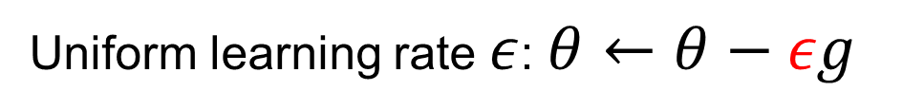
Uniform learning rate $ε$: $θ←θ−εg$
# individually adaptive learning rate
# rapid decrease with large g
# greater progress in the more gently sloped directions

Slide 17
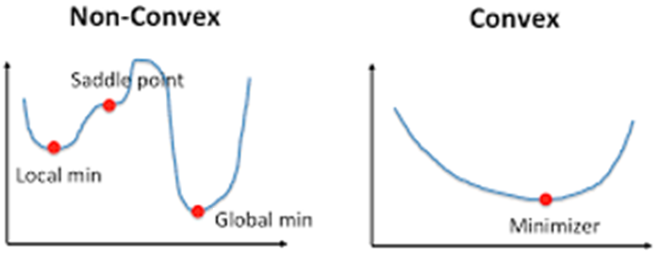
RMSProp
The RMSProp algorithm
modifies AdaGrad to perform better in the non-convex setting by changing the gradient accumulation into an exponentially weighted moving average.
AdaGrad is designed to converge rapidly when applied to a convex function. When applied to a non-convex function to train a neural network, the learning trajectory may pass through many different structures and eventually arrive at a region that is a locally convex bowl.
AdaGrad shrinks the learning rate according to the entire history of the squared gradient and may have made the learning rate too small before arriving at such a convex structure.
RMSProp uses an exponentially decaying average to discard history from the extreme past so that it can converge rapidly after finding a convex bowl, as if it were an instance of the AdaGrad algorithm initialized within that bowl.

Slide 18
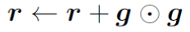
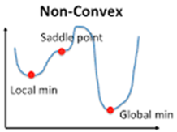
# exponentially decaying
// converge rapidly after finding a convex bowl

Slide 19
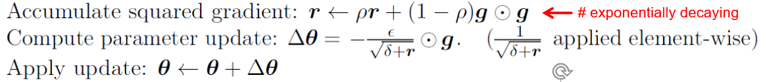
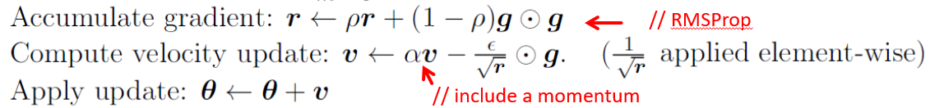
RMSProp + Momentum
RMSProp is shown in its standard form in algorithm 8.5 and combined with Nesterov momentum in algorithm 8.6.
Compared to AdaGrad, the use of the moving average introduces a new hyperparameter, ρ, that controls the length scale of the moving average.
Empirically, RMSProp has been shown to be an effective and practical optimization algorithm for deep neural networks.
It is currently one of the go-to optimization methods being employed routinely by deep learning practitioners.
+ momentum

Slide 20
// include a momentum
// RMSProp
// include a momentum

Slide 21
Adaptive Moments (Adam)
Adam (adaptive moments) perhaps best seen as a variant on the combination of RMSProp and momentum with a few important distinctions.
First, in Adam, momentum is incorporated directly as an estimate of the first order moment (with exponential weighting) of the gradient. The most straightforward way to add momentum to RMSProp is to apply momentum to the rescaled gradients. The use of momentum in combination with rescaling does not have a clear theoretical motivation.
Second, Adam includes bias corrections to the estimates of both the first-order moments (the momentum term) and the (uncentered) second-order moments to account for their initialization at the origin (see algorithm 8.7).
RMSProp also incorporates an estimate of the (uncentered) second-order moment, however it lacks the correction factor. Thus, unlike in Adam, the RMSProp second-order moment estimate may have high bias early in training.
Adam is generally regarded as being fairly robust to the choice of hyperparameters, though the learning rate sometimes needs to be changed from the suggested default (0.001). You can generally leave it there.

Slide 22

momentum
like RMSProp
// adaptive moments
# decrease with large g

Slide 23


Batch Normalization
One of the most exciting recent innovations in optimizing deep neural networks and it is actually not an optimization algorithm at all.
A technique for improving the speed, performance, and stability of ANN.
It is used to normalize the input layer by adjusting and scaling the activations.
Provides an elegant way of reparametrizing almost any deep network.
Can be applied to any input or hidden layer in a network.
Without batch normalization, the outputs of hidden layers could be very large or small.

Slide 24








Problem with Value Update
Very deep models involve the composition of several functions or layers. The gradient tells how to update each parameter, under the assumption that the other layers do not change.
In practice, we update all of the layers simultaneously.
When we make the update, unexpected results can happen because many functions composed together are changed simultaneously, using updates that were computed under the assumption that the other functions remain constant.
Suppose we have a deep neural network that has only one unit per layer and does not use an activation function at each hidden layer.
$$w_{1}$$
$$w_{2}$$
$$…$$
$$w_{l}$$
$$x$$
$\hat{y}$
Consider what happens when we make an update
// $\hat{y}$ may become exponentially small or large
The new value of $\hat{y}$ is given by
An example of one second-order term arising from this update is
This term might be negligible if is small, or might be exponentially large
if the weights on layers 3 through l are greater than 1.

Slide 25








Batch Normalization
Let H be a minibatch of activations of the layer to normalize, arranged as a design matrix, with the activations for each example appearing in a row of the matrix. To normalize H, we replace it with
$${H=\left[\begin{matrix}1.8 & … & 1.7 \\ … & … & … \\ 1.6 & … & 1.1\end{matrix}\right]}_{m×n}$$
m: minibatch size
n: no. of units
$${μ=\left[\begin{matrix}μ_{1} & … & μ_{n}\end{matrix}\right]}_{1×n}$$
where H_{i} is the i^{th} row of H, m is the size of minbatch, μ is a vector containing the mean of each unit, σ is a vector containing the standard deviation of each unit and δ is a small positive value such as 10⁻⁸ imposed to avoid encountering the undefined gradient of √z at z = 0.
$${σ=\left[\begin{matrix}σ_{1} & … & σ_{n}\end{matrix}\right]}_{1×n}$$
The arithmetic here is based on broadcasting the vector μ and the vector σ to be applied to every row of the matrix H. Within each row, the arithmetic is element-wise, so H_{i,j} is normalized by subtracting μ_{j} and dividing by σ_{j} .
…
m inputs
n
H_{i,1}
$$H_{i,1}^{′}$$
BN
($μ_{1},σ_{1}$)

Slide 26







Normalizing the mean and standard deviation of a unit can reduce the expressive power of the neural network containing that unit.
In order to maintain the expressive power of the network, it is common to replace the batch of hidden unit activations H with γH’ + β rather than simply the normalized H’.
The variables γ and β are learned parameters that allow the new variable to have any mean and standard deviation.
z¹
…
z^{n}
H
$${H=\left[\begin{matrix}1.8 & … & 1.7 \\ … & … & … \\ 1.6 & … & 1.1\end{matrix}\right]}_{m×n}$$
$${μ=\left[\begin{matrix}μ^{1} & … & μ^{n}\end{matrix}\right]}_{1×n}$$
$${σ=\left[\begin{matrix}σ^{1} & … & σ^{n}\end{matrix}\right]}_{1×n}$$
m: minibatch size
n: no. of units
H
H’
γH’ + β

Slide 27


Batch normalization
Layer normalization
As batch normalization is dependent on batch size, it’s not effective for small batch sizes.
Layer normalization is independent of the batch size, so it can be applied to batches with smaller sizes as well.
As batch normalization depends on batch statistics for normalization, it is less suited for sequence models.

Slide 28




Applying L2 Regularization and Batch Normalization
from keras.datasets import mnist
import numpy
from keras.datasets import mnist
from keras.models import Sequential
from keras.layers import Dense
from keras.layers import Dropout
from keras.utils import np_utils
(X_train, y_train), (X_test, y_test) = mnist.load_data()
28×28 pixels
$$x$$
$$W_{784×1000}$$
$$h$$
num_pixels = X_train.shape[1] * X_train.shape[2]
X_train = X_train.reshape(X_train.shape[0], num_pixels).astype('float32')
X_test = X_test.reshape(X_test.shape[0], num_pixels).astype('float32')
$$W_{1000×10}$$
$$\hat{y}$$
y_train = np_utils.to_categorical(y_train)
y_test = np_utils.to_categorical(y_test)
num_classes = y_test.shape[1]
$${H=\left[\begin{matrix}1.7 & … & 1.6 \\ … & … & … \\ 1.2 & … & 1.8\end{matrix}\right]}_{1024×1000}$$
model = Sequential()
model.add(Dense(1000, input_dim=784,activation='relu', kernel_regularizer = l2(0.01)))
model.add(BatchNormalization())
model.add(Dense(10, activation='softmax', kernel_regularizer = l2(0.01)))
from keras.optimizers import Adam
model.compile(loss='categorical_crossentropy', optimizer='adam', metrics=['accuracy'])
history = model.fit(X_train, y_train, validation_data=(X_test, y_test), epochs=100, batch_size=1024, verbose=1)
BN
$H$’

Slide 29
import keras
from keras.models import Sequential
from keras.layers import Dense, Activation, BatchNormalization
model = Sequential([
Dense(units=10, input_shape=(1,4), activation='relu'),
# add batchnorm layer after activations in the previous layer
BatchNormalization(axis=1),
# pre-activations at the dense layer below are Gaussians
Dense(units=16, activation='relu'),
BatchNormalization(axis=1),
Dense(units=4, activation='softmax')
])
Layer normalization
import keras
from keras.models import Sequential
from keras.layers import Dense, Activation, LayerNormalization
model = Sequential([
Dense(units=16, input_shape=(1,10), activation='relu'),
LayerNormalization(axis=1),
Dense(units=10, activation='relu'),
LayerNormalization(axis=1),
Dense(units=3, activation='softmax')
])
Batch normalization

Slide 30

Training of the Network
Dropout is a regularization technique used to minimize overfitting. Based on affine transformations, several units are randomly dropped from the network.
A large mini batch size takes too long per iteration and a small batch size does not reach the local minima.
The cost function on the mini batch trends downward but does not always decrease, unlike the batch gradient descent.
Adam, also referred to as adaptive moments
a learning rate optimization technique that is an enhancement of the combination of RMSProp and moments technique.
The rationale for selecting Adam as the learning algorithm is that it requires less memory and is best suited for sparse parameters.
Min-Batch/SGD
GD
m = N

Slide 31



Exponentially Weighted Moving Average
$$θ←αθ+\left(1−α\right)x$$
Example: $θ←0.5θ+0.5x$
Data: {1, 2, 3}
Sequential Input: 1, 2, 3
1 | $$θ=0.5∗0+0.5∗1=0.5$$
2 | $$θ=0.5∗0.5+0.5∗2=0.25+1=1.25$$
3 | $$θ=0.5∗1.25+0.5∗3=0.625+1.5=2.125$$
Sequential Input: 3, 2, 1
3 | $$θ=0.5∗0+0.5∗3=1.5$$
2 | $$θ=0.5∗1.5+0.5∗2=0.75+1=1.75$$
1 | $$θ=0.5∗1.75+0.5∗1=0.875+0.5=1.375$$
Averages of both are the same, namely, 2

